Slide 1



Department of Computer Engineering
LECTURE
Unit no.: 6
Unit title: Hibernate
Subject name & code: Advanced Java Programming (01CE0502)
Prof. Jatin Ambasana

Slide 2

Disclaimer
It is hereby declared that the production of the said content is meant for non-commercial, scholastic and research purposes only.
We admit that some of the content or the images provided in this channel's videos may be obtained through the routine Google image searches and few of them may be under copyright protection. Such usage is completely inadvertent.
It is quite possible that we overlooked to give full scholarly credit to the Copyright Owners. We believe that the non-commercial, only-for-educational use of the material may allow the video in question fall under fair use of such content. However we honour the copyright holder's rights and the video shall be deleted from our channel in case of any such claim received by us or reported to us.

Slide 3
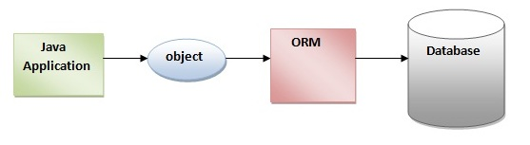
INTRODUCTION
Hibernate framework simplifies the development of java application to interact with the database.
Hibernate is an open source, lightweight, ORM (Object Relational Mapping) tool.
An ORM tool simplifies the data creation, data manipulation and data access.
It is a programming technique that maps the object to the data stored in the database.
The ORM tool internally uses the JDBC API to interact with the database.

Slide 4
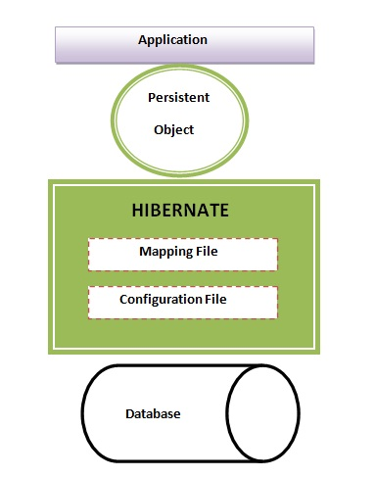
Hibernate Architecture
There are 4 layers in hibernate architecture java:
Application layer,
Hibernate framework layer,
Backhand api layer and
Database layer.

Slide 5
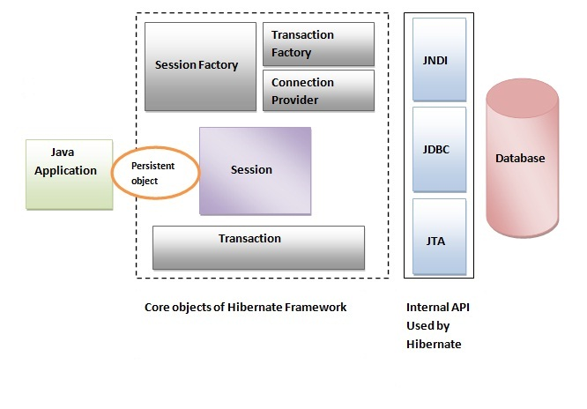
Elements of Hibernate Architecture
SessionFactory : Provides factory method to get the object of Session.
Session : Provides an interface between the application and data stored in the database.
A short-lived object
It wraps the JDBC connection
The org.hibernate.Session interface provides methods to insert, update and delete the object.
It also provides factory methods for Transaction and Query.

Slide 6
Elements of Hibernate Architecture
Transaction : org.hibernate.Transaction interface provides methods for transaction management.
ConnectionProvider : It is a factory of JDBC connections.
TransactionFactory : It is a factory of Transaction. It is optional.

Slide 7
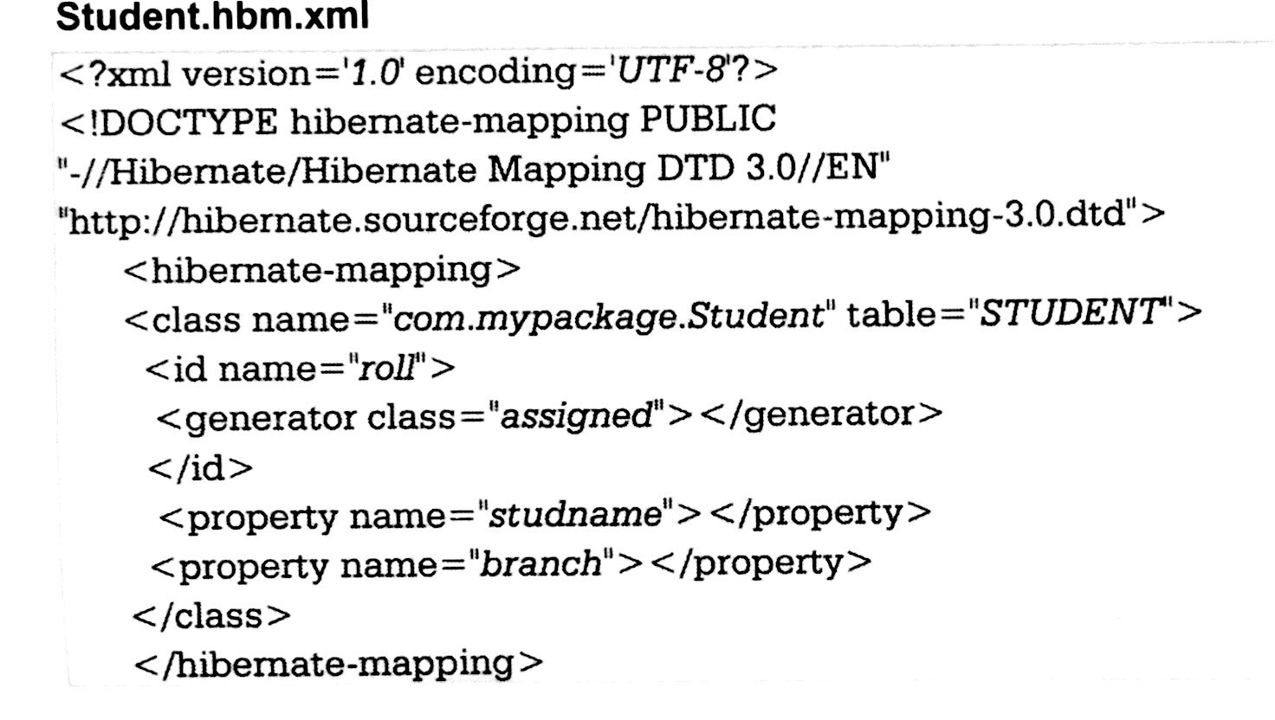
HIBERNATE O/R MAPPING
O/R Mapping is usually defined in XML document.
The mapping language is java-centric, meaning that mapping is constructed around persistence class declaration.

Slide 8
HIBERNATE O/R MAPPING
The mapping document is an XML document having <hibernate-mapping> as the root element which contains <class> elements corresponding class.
The <class> elements are used to define specific mappings from a Java classes to the database tables. The Java class name is specified using the name attribute of the class element and the database table name is specified using the table attribute.
The <id> element maps the unique ID attribute in class to the primary key of the database table. The name attribute of the id element refers to the property in the class.
The <generator> element within the id element is used to generate the primary key values automatically. The class attribute of the generator element is set to native to let hibernate pick up either identity, sequence to create primary key depending upon the capabilities of the underlying database.
The <property> element is used to map a Java class property to a column in the database table. The name attribute of the element refers to the property in the class and the column attribute refers to the column in the database table. The type attribute holds the hibernate mapping type, this mapping types will convert from Java to SQL data type.

Slide 9
HIBERNATE QUERY LANGUAGE(HQL)
Hibernate is supported by a very powerful query language which is just similar to SQL.
The Hibernate query language is an object oriented query language.
It works with persistent object and its property.
HQL does not depends upon table of database. Instead of table name we use class name in HQL.
The Hibernate query are converted into conventional query that in turn perform operation.
These query are case sensitive.

Slide 10
Difference between HQL and SQL:
HQL stands for Hibernate Query Language and SQL stands for Structured Query Language
The structure of HQL is similar to SQL, but the main deference is that HQL makes use of class name instead of table and property name.
HQL is object oriented query language and sql is not.
HQL is database independent where as SQL is database dependent.

Slide 11
Advantages of HQL:
The HQL can perform bulk of operation at a time on Hibernate.
HQL supports object oriented feature such as inheritance, polymorphism, association and so on.
Instead of returning plain data HQL return object. These objects can be easily accessed or programmed.
HQL is database independent. The same HQL can be executed on different databases.

Slide 12
HQL Interface:
public int executeUpdate() is used to execute the update or delete query.
public List list() returns the result of the ralation as a list.
public Query setFirstResult(int rowno) specifies the row number from where record will be retrieved.
public Query setMaxResult(int rowno) specifies the no. of records to be retrieved from the relation (table).

Slide 13
SOME COMMON QUERRY IN HQL:
HQL to get all the records
Query query=session.createQuery("from Emp");//here persistent class name is Emp
List list=query.list();
HQL to get records with pagination
Query query=session.createQuery("from Emp");
query.setFirstResult(5);
query.setMaxResult(10);
List list=query.list();//will return the records from 5 to 10th number

Slide 14
SOME COMMON QUERRY IN HQL:
HQL delete query
Query query=session.createQuery("delete from Emp where id=100");
//specifying class name (Emp) not tablename
query.executeUpdate();

Slide 15
Introduction
What is JDBC?
JDBC stands for Java Database Connectivity and provides a set of Java API for accessing the relational databases from Java program.
These Java APIs enables Java programs to execute SQL statements and interact with any SQL database.
JDBC provides a flexible architecture to write a database independent application that can run on different platforms and interact with different DBMS.

Slide 16
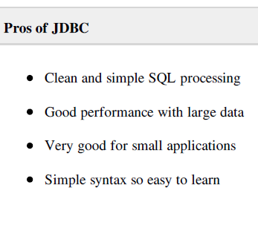
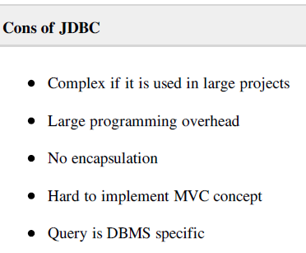
Pros and Cons of JDBC

Slide 17
Example
public class Employee {
private int id;
private String first_name;
private String last_name;
private int salary;
public Employee() {}
public Employee(String fname, String lname, int salary) {
this.first_name = fname;
this.last_name = lname;
this.salary = salary;
}

Slide 18
Cont.
public int getId() {
return id; }
public String getFirstName() {
return first_name; }
public String getLastName() {
return last_name; }
public int getSalary() {
return salary; } }

Slide 19
RDBMS table
create table EMPLOYEE (
id INT NOT NULL auto_increment,
first_name VARCHAR(20) default NULL,
last_name VARCHAR(20) default NULL,
salary INT default NULL,
PRIMARY KEY (id)
);

Slide 20
Problems
First problem, what if we need to modify the design of our database after having developed few pages or our application?
Second, Loading and storing objects in a relational database exposes us to the following five mismatch problems.

Slide 21
Problems??
Mismatch Description
Granularity : Sometimes you will have an object model which has more classes than the number of corresponding tables in the database.
Inheritance : RDBMSs do not define anything similar to Inheritance which is a natural paradigm in object-oriented programming languages.

Slide 22
Problems??
Identity : A RDBMS defines exactly one notion of 'sameness': the primary key. Java, however, defines both object identity (a==b) and object equality (a.equals(b)).
Associations : Object-oriented languages represent associations using object references where as am RDBMS represents an association as a foreign key column.
Navigation : The ways you access objects in Java and in a RDBMS are fundamentally different.

Slide 23
Hibernate
Hibernate is a high-performance Object/Relational and query service which is licensed under the open source GNU Lesser General Public License (LGPL) and is free to download.
Hibernate not only takes care of the mapping from Java classes to database tables (and from Java data types to SQL data types), but also provides data query and retrieval facilities.

Slide 24
Why Object Relational Mapping (ORM)?
When we work with an object-oriented systems, there's a mismatch between the object model and the relational database.
RDBMSs represent data in a tabular format whereas object-oriented languages, such as Java or C# represent it as an interconnected graph of objects.

Slide 25
What is ORM?
Object-Relational Mapping (ORM) is the solution to handle all the mismatches.
ORM stands for Object-Relational Mapping (ORM) is a programming technique for converting data between relational databases and object oriented programming languages such as Java, C# etc.

Slide 26
Cont.
Hibernate maps Java classes to database tables and from Java data types to SQL data types and relieve the developer from 95% of common data persistence related programming tasks.
Hibernate sits between traditional Java objects and database server to handle all the work in persisting those objects based on the appropriate O/R mechanisms and patterns.

Slide 27
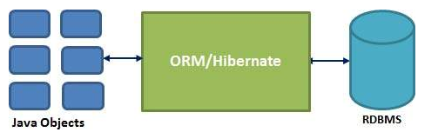
Cont.

Slide 28
Hibernate Advantages
Hibernate takes care of mapping Java classes to database tables using XML files and without writing any line of code.
Provides simple APIs for storing and retrieving Java objects directly to and from the database.
If there is change in Database or in any table then the only need to change XML file properties.

Slide 29
Architecture
The Hibernate architecture is layered to keep you isolated from having to know the underlying APIs.
Hibernate makes use of the database and configuration data to provide persistence services (and persistent objects) to the application.
Persistent Objects are the ones who give an indication that the state of an object would be permanently stored even after the execution of the program.

Slide 30
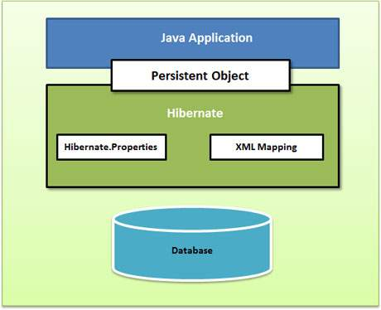
Cont.
Following is a very high level view of the Hibernate Application Architecture.

Slide 31
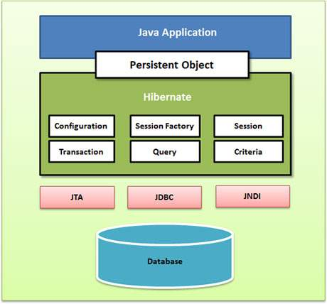
Cont.
Following is a detailed view of the Hibernate Application Architecture with few important core classes.

Slide 32
Cont.
Hibernate uses various existing Java APIs, like JDBC, Java Transaction API(JTA), and Java Naming and Directory Interface (JNDI).
JDBC provides abstraction of functionality common to relational databases, allowing almost any database with a JDBC driver to be supported by Hibernate.
JNDI and JTA allow Hibernate to be integrated with J2EE application servers.

Slide 33
Cont.
Configuration Object:
The Configuration object is the first Hibernate object you create in any Hibernate application and usually created only once during application initialization.
SessionFactory Object:
Configuration object is used to create a SessionFactory object which inturn configures Hibernate for the application using the supplied configuration file and allows for a Session object to be instantiated.

Slide 34
Cont.
Transaction Object:
A Transaction represents a unit of work with the database and most of the RDBMS supports transaction functionality.
Transactions in Hibernate are handled by an underlying transaction manager and transaction.

Slide 35
Cont.
Query Object:
Query objects use SQL or Hibernate Query Language (HQL) string to retrieve data from the database and create objects. A Query instance is used to bind query parameters, limit the number of results returned by the query, and finally to execute the query.
Criteria Object:
Criteria object are used to create and execute object oriented criteria queries to retrieve objects.

Slide 36
Hibernate - O/R Mappings
These are the 3 mapping.
Mapping of collections,
Mapping of associations between entity classes
Component Mappings.

Slide 37
Cont.
Collections Mappings:
If an entity or class has collection of values for a particular variable, then we can map those values using any one of the collection interfaces available in java.
Hibernate can persist instances of java.util.Map, java.util.Set, java.util.SortedMap, java.util.SortedSet, java.util.List, and any array of persistent entities or values.

Slide 38
Cont.
.
Collection type | Mapping and Description
java.util.Set | This is mapped with a <set> element and initialized with java.util.HashSet
java.util.SortedSet | This is mapped with a <set> element and initialized with java.util.TreeSet. The sort attribute can be set to either a comparator or natural ordering.
java.util.List | This is mapped with a <list> element and initialized with java.util.ArrayList
java.util.Collection | This is mapped with a <bag> or <ibag> element and initialized with java.util.ArrayList
java.util.Map | This is mapped with a <map> element and initialized with java.util.HashMap
java.util.SortedMap | This is mapped with a <map> element and initialized with java.util.TreeMap. The sort attribute can be set to either a comparator or natural ordering.

Slide 39
Cont.
If you want to map a user defined collection interfaces which is not directly supported by Hibernate, you need to tell Hibernate about the semantics of your custom collections

Slide 40
Cont.
Association Mappings:
The mapping of associations between entity classes and the relationships between tables is the soul of ORM.
Following are the four ways in which the cardinality of the relationship between the objects can be expressed.
An association mapping can be unidirectional as well as bidirectional.

Slide 41
Cont.
Mapping type | Description
Many-to-One | Mapping many-to-one relationship using Hibernate
One-to-One | Mapping one-to-one relationship using Hibernate
One-to-Many | Mapping one-to-many relationship using Hibernate
Many-to-Many | Mapping many-to-many relationship using Hibernate
.

Slide 42
Cont.
Component Mappings:
It is very much possible that an Entity class can have a reference to another class as a member variable.
If the referred class does not have it's own life cycle and completely depends on the life cycle of the owning entity class, then the referred class hence therefore is called as the Component class.

Slide 43
Cont.
Mapping type | Description
Component Mappings | Mapping for a class having a reference to another class as a member variable.
.

Slide 44
Hibernate - Mapping Files
An Object/relational mappings are usually defined in an XML document.
This mapping file instructs Hibernate how to map the defined class or classes to the database tables.

Slide 45
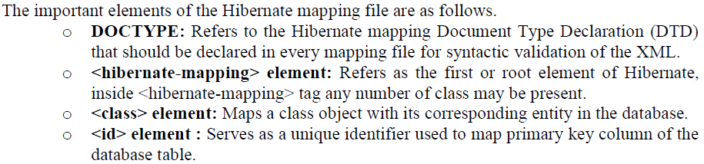
Cont.

Slide 46
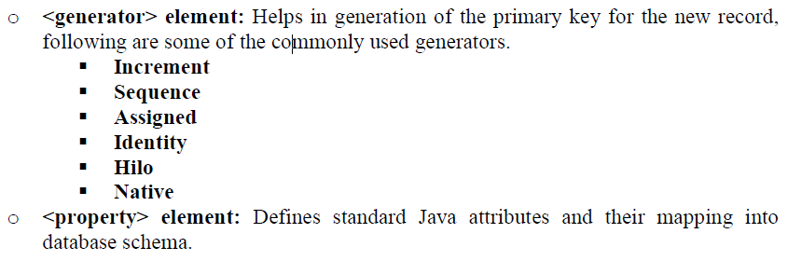
Cont.

Slide 47
Hibernate - Mapping Types
When you prepare a Hibernate mapping document, we have seen that you map Java data types into RDBMS data types.
The types declared and used in the mapping files are not Java data types; they are not SQL database types either.
These types are called Hibernate mapping types, which can translate from Java to SQL data types and vice versa.

Slide 48
Cont.
Primitive types:
Mapping type | Java type | ANSI SQL Type
integer | int or java.lang.Integer | INTEGER
long | long or java.lang.Long | BIGINT
short | short or java.lang.Short | SMALLINT
float | float or java.lang.Float | FLOAT
double | double or java.lang.Double | DOUBLE
big_decimal | java.math.BigDecimal | NUMERIC

Slide 49
Cont.
Date and time types:
Mapping type | Java type | ANSI SQL Type
date | java.util.Date or java.sql.Date | DATE
time | java.util.Date or java.sql.Time | TIME
timestamp | java.util.Date or java.sql.Timestamp | TIMESTAMP
calendar | java.util.Calendar | TIMESTAMP
calendar_date | java.util.Calendar | DATE

Slide 50
Cont.
Binary and large object types:
Mapping type | Java type | ANSI SQL Type
binary | byte[] | VARBINARY (or BLOB)
text | java.lang.String | CLOB
serializable | any Java class that implements java.io.Serializable | VARBINARY (or BLOB)
clob | java.sql.Clob | CLOB
blob | java.sql.Blob | BLOB

Slide 51
Cont.
JDK-related types:
Mapping type | Java type | ANSI SQL Type
class | java.lang.Class | VARCHAR
locale | java.util.Locale | VARCHAR
timezone | java.util.TimeZone | VARCHAR
currency | java.util.Currency | VARCHAR

Slide 52
HIBERNATE QUERY LANGUAGE
Hibernate Query Language (HQL) is an object-oriented query language, similar to SQL, but instead of operating on tables and columns, HQL works with persistent objects and their properties.
HQL queries are translated by Hibernate into conventional SQL queries which in turns perform action on database.

Slide 53
Cont.
Although you can use SQL statements directly with Hibernate using Native SQL but It would recommend to use HQL whenever possible to avoid database portability hassles, and to take advantage of Hibernate's SQL generation.
Keywords like SELECT , FROM and WHERE etc. are not case sensitive but properties like table and column names are case sensitive in HQL.

Slide 54
FROM Clause
You will use FROM clause if you want to load a complete persistent objects into memory. Following is the simple
String hql = "FROM Employee";
Query query = session.createQuery(hql);
List results = query.list();
If you need to fully qualify a class name in HQL, just specify the package and class name as follows:
String hql = "FROM com.hibernatebook.criteria.Employee";
Query query = session.createQuery(hql);
List results = query.list();

Slide 55
SELECT Clause
The SELECT clause provides more control over the result set than the from clause. If you want to obtain few properties of objects instead of the complete object, use the SELECT clause.
Following is the simple syntax of using SELECT clause to get just first_name field of the Employee object:
String hql = "SELECT E.firstName FROM Employee E";
Query query = session.createQuery(hql);
List results = query.list();

Slide 56
WHERE Clause
If you want to narrow the specific objects that are returned from storage, you use the WHERE clause.
Following is the simple syntax of using WHERE clause:
String hql = "FROM Employee E WHERE E.id = 10";
Query query = session.createQuery(hql);
List results = query.list();

Slide 57
ORDER BY Clause
To sort your HQL query's results, you will need to use the ORDER BY clause. of using ORDER BY clause:
String hql = "FROM Employee E WHERE E.id > 10 ORDER BY E.salary DESC";
Query query = session.createQuery(hql);
List results = query.list();
If you wanted to sort by more than one property, clause, separated by commas as follows:
String hql = "FROM Employee E WHERE E.id > 10 " +
"ORDER BY E.firstName DESC, E.salary DESC ";
Query query = session.createQuery(hql);
List results = query.list();

Slide 58
GROUP BY Clause
This clause lets Hibernate pull information from the database and group it based on a value of an attribute and, typically, use the result to include an aggregate value
String hql = "SELECT SUM(E.salary), E.firstName FROM Employee E " +
"GROUP BY E.firstName";
Query query = session.createQuery(hql);
List results = query.list();

Slide 59
UPDATE Clause
The Query interface now contains a method called executeUpdate() for executing HQL UPDATE or DELETE statements.
String hql = "UPDATE Employee set salary = :salary " +
"WHERE id = :employee_id";
Query query = session.createQuery(hql);
query.setParameter("salary", 1000);
query.setParameter("employee_id", 10);
int result = query.executeUpdate();
System.out.println("Rows affected: " + result);

Slide 60
DELETE Clause
The DELETE clause can be used to delete one or more objects. Following is the simple syntax of using DELETE clause:
String hql = "DELETE FROM Employee " +
"WHERE id = :employee_id";
Query query = session.createQuery(hql);
query.setParameter("employee_id", 10);
int result = query.executeUpdate();
System.out.println("Rows affected: " + result);

Slide 61
INSERT Clause
HQL supports INSERT INTO clause only where records can be inserted from one object to another object.
String hql = "INSERT INTO Employee(firstName, lastName, salary)" +
"SELECT firstName, lastName, salary FROM old_employee";
Query query = session.createQuery(hql);
int result = query.executeUpdate();
System.out.println("Rows affected: " + result);

Slide 62
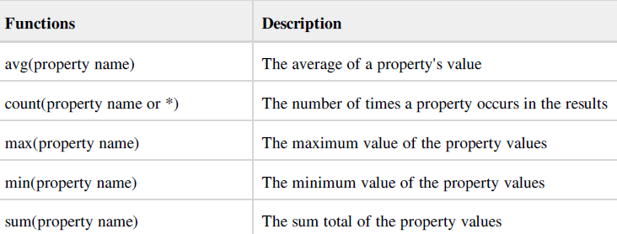
Aggregate Methods
HQL supports a range of aggregate methods, similar to SQL. They work the same way in HQL as in SQL and following is the list of the available functions:

